Slide 1
New York Planning Federation
Presentation
SEQR
April 13, 2015

Slide 2
Overview
  Know What SEQR is.
  Know The general processes and procedures.
  Assist your community with SEQR on a routine basis.
  The impacts of the new required forms.

Slide 3
Who is the Audience?
  Planning Boards, Code Officials, and others
  Levels of Expertise:
  “Seeker”
  Novice
  Routine
  Black Belt?
Phil Duchscherer

Slide 4
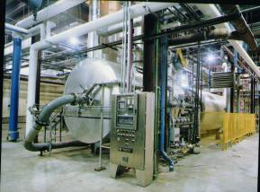

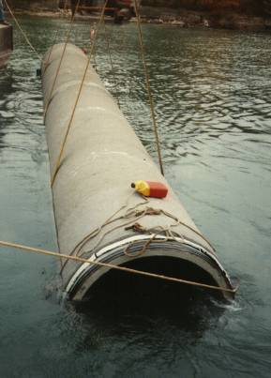
Resources
Where is the best place to find information on SEQR?
  6 NYCRR Part 617 State Environmental Quality Review
  DEC website

Slide 5
Question?
Why must SEQR be completed
on most actions?

Slide 6
Question?
  Because you have to.
  It will help to make a successful project.
  Because you could get sued if you don’t.
  All of the above.

Slide 7
SEQR
State Environmental Quality Review

Slide 8
SEQR
Required by the State Environmental Quality Review Act (SEQRA) – 19 NYCRR Part 617, as promulgated by the NYSDEC.
SEQR equates to an environmental overlay on local land use review and approval.
SEQR is built on the recognition that we are all stewards of the environment and, as such, should include environmental consideration in our planning, review and decision making processes.
Amherst Office
Washington Office

Slide 9
What SEQR Is and Is Not?
SEQR is NOT a permit or approval.
SEQR is an additional review that enables state and local agencies to evaluate the environmental effects of their decisions.
SEQR is activated when a state or local agency must make a discretionary decision.
Washington Office

Slide 10
What is Subject to SEQR?
Any action (project or physical activity) that is directly undertaken, or funded by, or requires a discretionary permit or approval from a municipal agency.
Washington Office

Slide 11
Examples
Site plans
Subdivision of land
Special use permits
Rezoning of land
Use variances and some area variances
Adoption of plans or local legislation
Purchase of property
Funding of projects, etc.
Other?

Slide 12
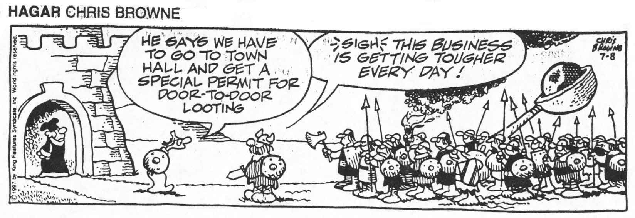
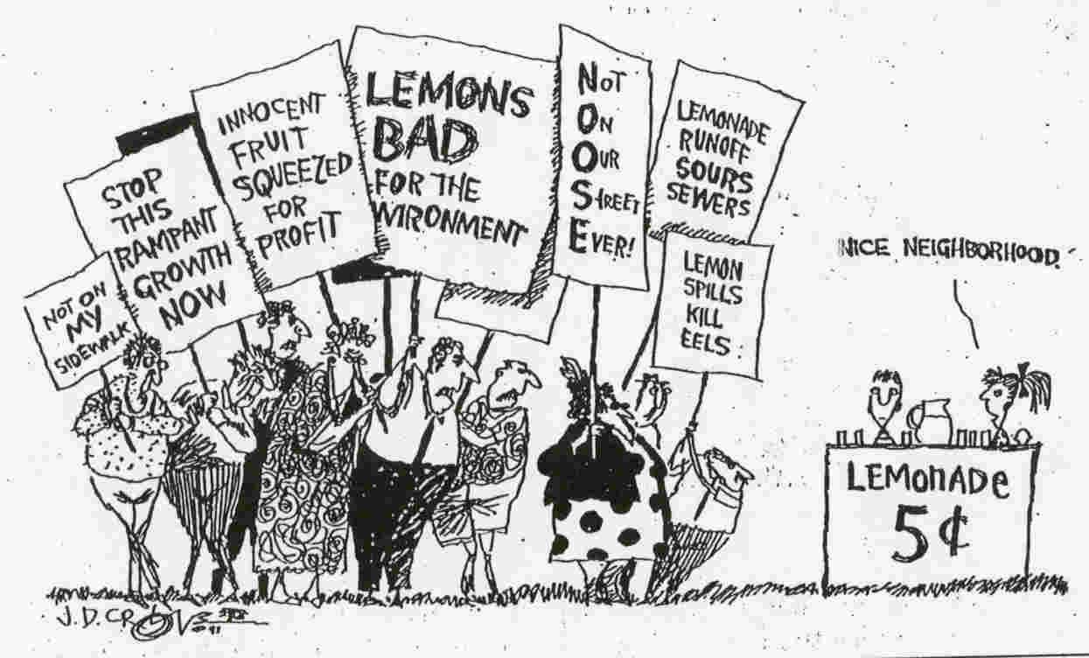

Slide 13
The Process
When to start the SEQR review process
(as early as possible in process).
Who Starts (Lead Agency, Involved Agencies, Interested Agencies) – Typically started by a local government board: PB, TB, and infrequently a ZBA.
Washington Office

Slide 14
Classifying an Action
  Type I
  Type II
  Unlisted

Slide 15
Classifying an Action
Type I:
  Have the potential for significant environmental impacts
  Listed in the regulations
  Lower thresholds if affects Agricultural Districts (25%), Historic Properties (any), Parkland/Open Space (25%)

Slide 16
Classifying an Action
Type II: Exempt Action
  By law, do not have a significant environmental impact
  Specific listing in regulations
Unlisted: All other actions
MOST actions are Unlisted

Slide 17
Requirements for Each Type of Action

Slide 18
Requirements for Each Type of Action
Type I:
  Requires preparation of Full Environmental Assessment Form (EAF).
  Lead Agency must be established.
  Conduct coordinated review with involved and interested agencies.
  Type I actions tend to have impacts, but this does not mandate the preparation of an Environmental Impact Statement (EIS).
  Required Notices and Filings.

Slide 19
Requirements for Each Type of Action
Unlisted Action:
  Short Form EAF is used, but can use Full EAF.
  Coordinated Review not required, but is recommend if other agency approvals are required or if their input is desired.

Slide 20
Requirements for Each Type of Action
Type II:
  No action is required – Exempt from review.
  In some instances it is recommended that a Short Form EAF be completed and placed in municipal file (noting Type II Action).

Slide 21
Requirements for Each Type of Action
Full EAF
  Applicant completes Part 1 – Must be completed as best as possible, with signature.
  Agency reviews and asks questions concerning information contained on the form in an effort to evaluate potential project impacts.
  Agency completes Part 2 – Gain as much information as possible about the project (under the Part 1 effort get input from other agencies, the public and through research, etc.) before completing Part 2. A great tool for evaluating a Project!!
  Agency directs completion of Part 3, as necessary; back-up information, documentation, reports, studies, etc., to provide further detail for evaluation of potential environmental impacts.

Slide 22
Determination of Significance

Slide 23
Determination of Significance
Negative Declaration
  A statement that formally ends the SEQR process.
  A determination that the proposed action will not have a potential significant impact on the environment.
  Must be prepared in writing, identifying and evaluating the relevant areas of concern, and kept on file – must be a “reasoned elaboration” of the decision.
  For Type I actions, the Negative Declaration must be distributed to all Involved Agencies, and the applicant (and published in ENB).

Slide 24
Determination of Significance
Negative Declaration
  For unlisted actions, non-coordinated review: each agency makes their own decision.
  Supporting documentation must be included in the file.
  Must be adopted by formal resolution.
  Documentation, Documentation, Documentation.

Slide 25
Determination of Significance
Positive Declaration
  Action may result in impact on the environment.
  An EIS must be prepared.
  Get assistance.

Slide 26
SEQR: A Tool for Success

Slide 27
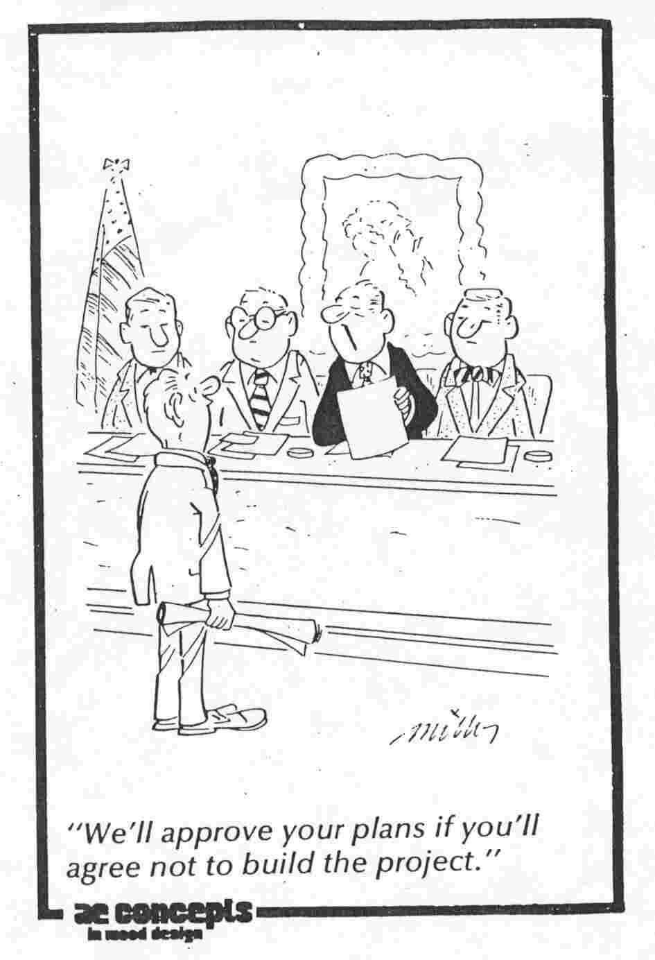
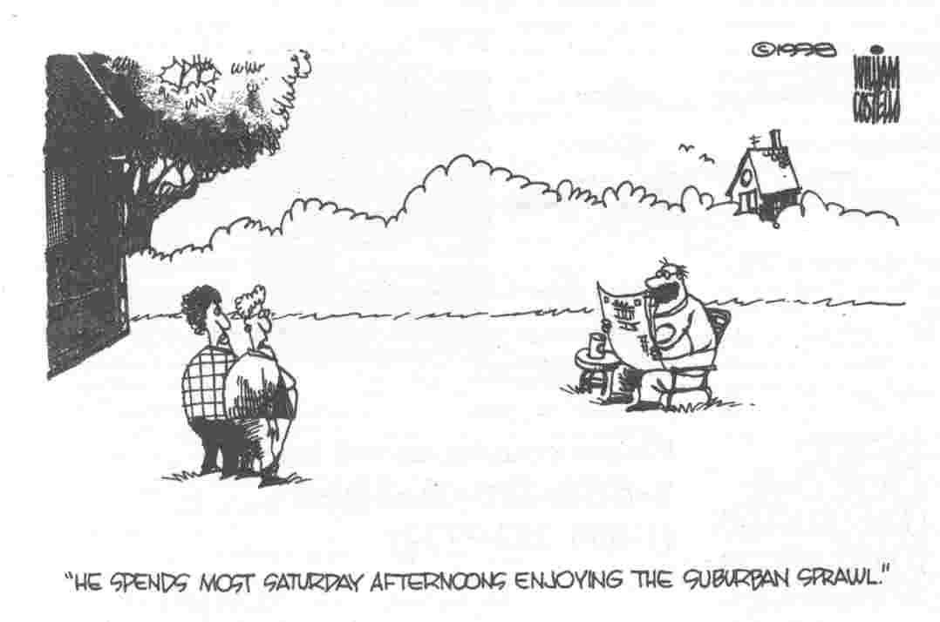
Any Questions?

Slide 28
SEQR Amendments
Adopted changes went into effect on October 7, 2013
New EAFs
Note:
The following slides are from a NYSDEC presentation.

Slide 29

New York State Department of Environmental Conservation
The New Environmental
Assessment Forms

Slide 30
Goals of EAF Revision Process
Reduce need for additional studies.
Encourage more use of the short EAF.
Make use of the internet and electronic technologies and use of gatekeeper questions.
Eliminate need for a separate determination of significance.
Serve as the starting point for scoping.
New York State Department of Environmental Conservation

Slide 31
Environmental Assessment Forms
  NEW:
  Forms were adopted by the Commissioner on January 25, 2012.
  Forms were originally effective on October 1, 2012; effective date was changed to April 1, 2013 and then to October 7, 2013 so that workbooks and GIS platform are available ahead of effective date.
New York State Department of Environmental Conservation

Slide 32
Environmental Assessment Forms
  DEC has prepared companion workbooks and is preparing web-based forms and upgrading GIS platform.
  Draft Short EAF workbook - comment period ended on 10/22/12.
  Draft Full EAF workbook - comment period ended on 5/20/13.
  Vendor has started work on the GIS platform (completed).
New York State Department of Environmental Conservation

Slide 33
The Updated EAF’s
How are they different?
  Topics covered
  Determination of significance is built into the form
  Fill-out-able on line
  Hyperlinks to workbook

Slide 34
EAF Workbooks
Workbook is intended to:
  lead sponsors through preparing Part 1;
  Guide lead agency in preparing Parts 2 & 3.
Workbooks provide links to spatial data (e.g., maps) and other sources of information for use in preparing forms.
Workbook makes generous use of examples.
Glossary of terms.
-
-
New York State Department of Environmental Conservation

Slide 35
SEAF – Part 1, 2 and 3
Questions and Full EAF

Slide 36
SEAF - Part 1, Question 1
Does the proposed action only involve the legislative adoption of a plan, local law, ordinance, or regulation?
If Yes, attach a narrative description of the intent of the proposed action and the environmental resources that may be affected in the municipality and proceed to Part 2.
If no, continue to Question 2.
New York State Department of Environmental Conservation

Slide 37
SEAF - Part 1, Question 3
a. Total acreage of the site?
b. Total acreage to be disturbed?
c. Total acreage (project site and any contiguous properties) owned or controlled by the applicant or project sponsor?
d. How to answer the questions.
New York State Department of Environmental Conservation

Slide 38
SEAF - Part 1, Question 4
Check all land uses that occur on adjoining, and near the proposed action?
  Urban?
  Rural (non-ag)?
  Industrial?
  Commercial?
  Residential (Suburban)?
Workbook help in answering the questions!
  Forest?
  Agriculture?
  Aquatic?
  Parkland?
  Other?
New York State Department of Environmental Conservation

Slide 39
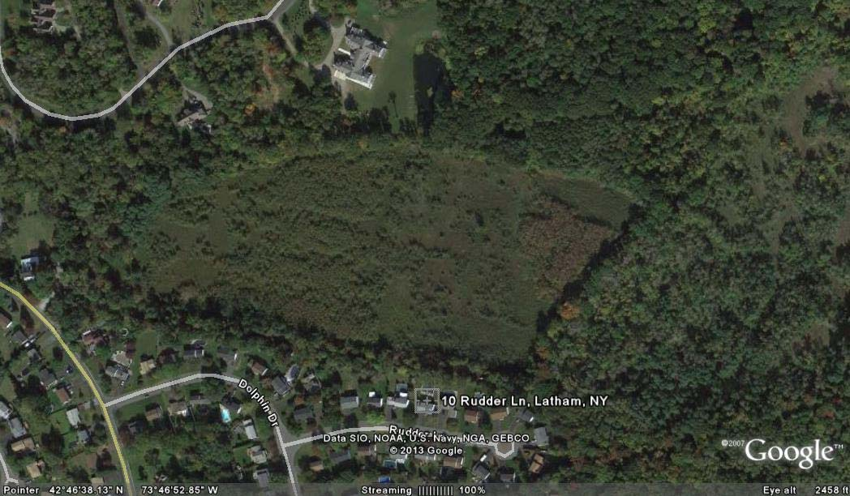
Internet Tools

Slide 40
SEAF - Part I, Question 12.b.
b. Is the proposed action located in an archeological sensitive area? This has created problems in certain communities!

Slide 41
Full EAF - Part 1
13 pages; with numerous new and more clarifying questions.
Air Emissions, public transportation, lighting, hazardous materials, contamination history, and wildlife species, etc.

Slide 42
SEAF - Part 2, Question 1
Will the proposed action create a material conflict with an adopted land use plan or zoning regulations?
Workbook help!
New York State Department of Environmental Conservation

Slide 43
SEAF - Part 2, Question 3
Will the proposed action impair the character or quality of the existing community?
Workbook help!
New York State Department of Environmental Conservation

Slide 44
SEAF - Part 2, Question 6
Will the proposed action cause an increase in the use of energy and it fails to incorporate reasonably available energy conservation or renewable energy opportunities?
Workbook help!
Has created some problems.

Slide 45
Full EAF - Part 2
10 pages; refers to Part 1 questions, includes more questions per “Impact area,” and still has “No/Small” category and “Moderate/Large” impact categories.
Some new questions will probably be litigated in the future.

Slide 46
Making the Determination of Significance - Part 3
The Lead Agency is responsible for the completion of Part 3.
For every question in Part 2 that was answered “moderate to large impact may occur”… please complete Part 3.
Can also use to document why impact was categorized as small.
Workbook help!
New York State Department of Environmental Conservation

Slide 47
Information and Links
Check the Environmental Notice Bulletin at: http://www.dec.ny.gov/enb/enb.html
Revised EAFs, draft workbooks & proposed regulatory changes at: http://www.dec.ny.gov/permits/6061.html
To be placed on service list e-mail us at: depprmt@gw.dec.state.ny.us
New York State Department of Environmental Conservation

Slide 48
You Made It Through SEQR Training!
?
Questions & Answers
Thank You
Andrew C. Reilly, PE, AICP
Wendel Director of Planning
& Environmental Services

